Slide 1


Location Model Overview
Overview
What is the Location Model?
How is it utilized?
2020 Review
Results
How it works
Process
Model Improvements
Data Accuracy
Location Performance
2020 Learnings
AMZL
Expiration
Suggested Improvements & Asks
Q&A
Amazon Hub Locker
Location Model & AMZL

Slide 2
Overview
What is the Location Model?
The Location Model geocodes the address of each proposed Locker location and collects both demographic data (income, education and population density) and Amazon data (first time delivery successes, delivery failures and package density) to determine the potential throughput at a given location.
More how this works in a moment.
What the Location Model does not do?
Demand Forecasting
The LM predicts the potential throughput for a given location. However, unlike a demand model it doesn't determine the demand across all areas. The Location Model requires an input to produce the output.
Financial Analysis
The location model does not determine rent ceilings or calculate the downstream impact of having a locker in a given location.

Slide 3
The Location Model - A Step in the Process
Analysis
Marketing
Prospecting
Location Model
Host locations are analyzed for AMZL coverage and grading
Survey
Approvals
Asset Load
Install
2020 Locations by Stage
328k
23k
5.9k
5.8k
5.7k

Slide 4
2020
Breakdown
Total Throughput | 328,513
Grade | AMZL | Not AMZL
A | 8228 | 3963
B | 66489 | 19349
B Upgrade - AC | 40224 | 20415
B Upgrade - CC | 19538 | 5479
B Upgrade - PD | 1890 | 466
C | 79204 | 56273
C Zero Rent | 2685 | 3566
D | 687 | 57
Total | 218,945 | 109,568

Slide 5
Location Model
Running the Location Model
AMZL Coverage Check
Airtable LM Intake
Address Validation
Location Model Output
Airtable LM Base
Location Grading
Update BD Sharepoint Folder
Address Validation
SmartyStreets
Determine AMZL Coverage
API with AMZL system that determines coverage by geocode
Location Grade
Utilizes two primary data sources
Amazon data
Census data

Slide 6
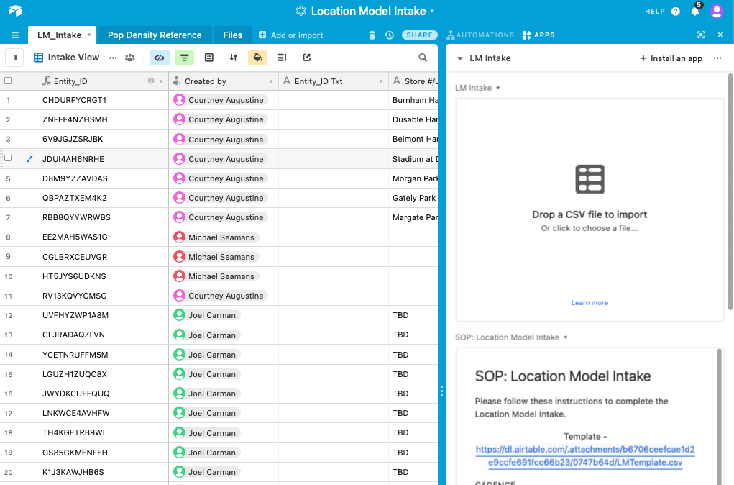
2020
Improvements
AirTable LM Intake
Address Validation
Availability Ranking
Training Data 2.0
AMZL Coverage Check
Jedi Coverage Check

Slide 7
Grade
&
Performance
Mature Locker | >1 Year
Packages - October – December 2020
New & Ramping Lockers | 0-12 Months
Packages - October – December 2020
Grade | Locker # | Avg Monthly Pkg
A | 1,170 | 354
B | 3,382 | 256
B Upgrade - AC | 1,267 | 165
B Upgrade - PD | 9 | 143
C | 459 | 163
D | 37 | 153
Total | 6325
Grade | # | Avg Monthly Pkg
A | 205 | 104
B | 3,117 | 49
B Upgrade – AC | 656 | 38
B Upgrade – PD | 2 | 38
C | 1,144 | 34
D | 49 | 33
Total | 5,175

Slide 8
2020
Learnings
AMZL Data
“False Positives”& Temp Delivery Stations
Lack of Data
Jedi Eligibility
Issue relating to sites with pre-2020 grades and temp AMZL Stations
We need the following data from AMZL (preferably through API): Jurisdiction & Ship Method
Currently, there is no real time data connection. Updating is manual. Potential Solution has been identified

Slide 9
2021
Suggested Improvements
& Asks of Leadership
Suggested Improvements
Grade Expiration
Odin Related Information
Leadership Asks
API Project Prioritization
We have not had gates in place to ensure that a given site has been graded within 100 days of survey, asset load or install.
Include jurisdiction type and ship methodology in a similar API call that is used to determines AMZL coverage
Our contact on the tech side with AMZL has stated that we can build a more robust API, however in order to get it done prior to mid Q3, we may need a leadership escalation to get it prioritized.

